Slide 1
How will Covid-19 impact on balneology – a perspective from Australia
28 April, 2020
Presenter
Charles Davidson
Chairman Peninsula Hot Springs
Chairman Global Wellness Institute Hot Springs Initiative
Vice President FEMTEC – Asia Pacific

Slide 2
Talk Contents
Hot springs – a global cultural health & wellbeing story
Hot springs bathing trails – globally connecting to local communities
PhD Research – Social, Environmental and Economic impact analysis
“A new balance can arise from this existential threat to humanity
that sees the environment and community sit alongside the economy
rather than being its servant.” Charles Davidson

Slide 3
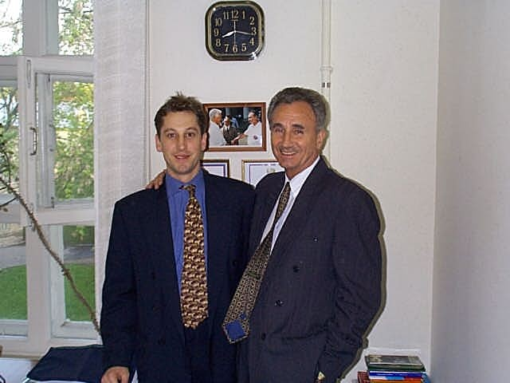
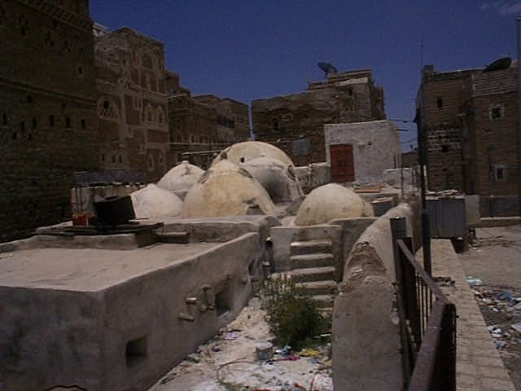
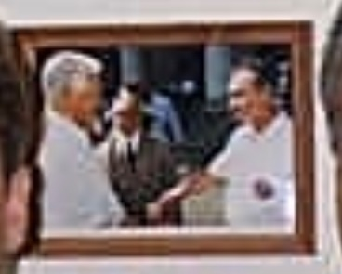
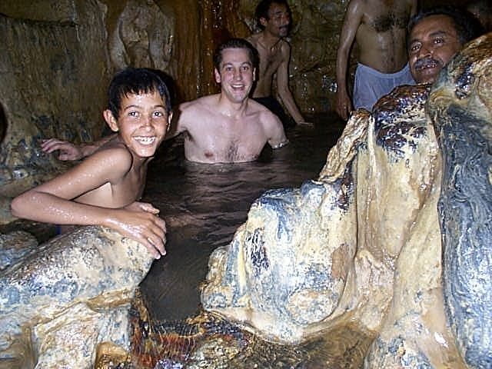
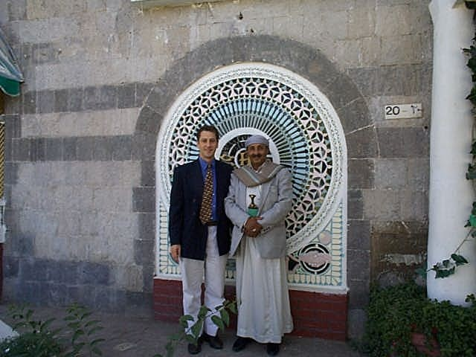
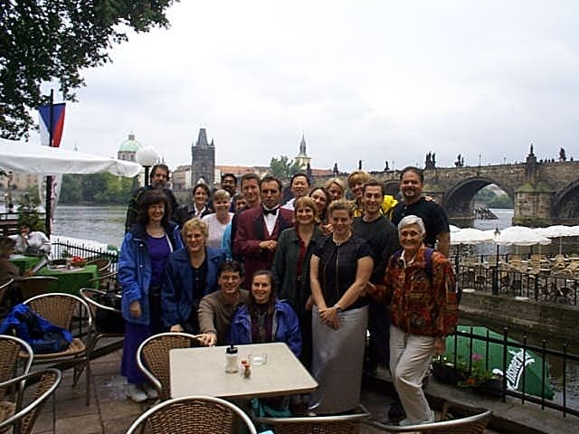
Notes:
Seeing is believing. Since 1992 - Travelling to 51 countries to research the global bathing practices to develop ‘international understanding through hot springs’. This initial formative trip from Japan to Russia, Czech Republic and Yemen. Yemen – at that time in 1998 the poorest country in the world with a GDP of US$320/capita (in 2016 Yemen was no.5 with US$762/capita per annum).

Slide 4
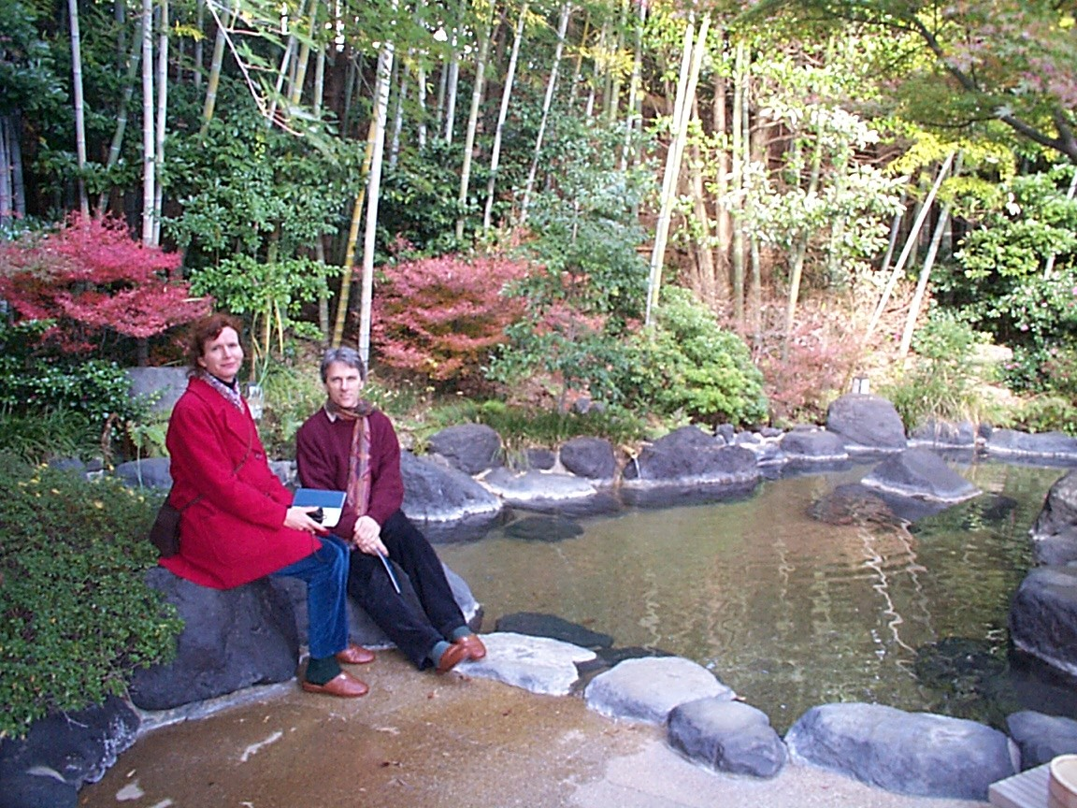
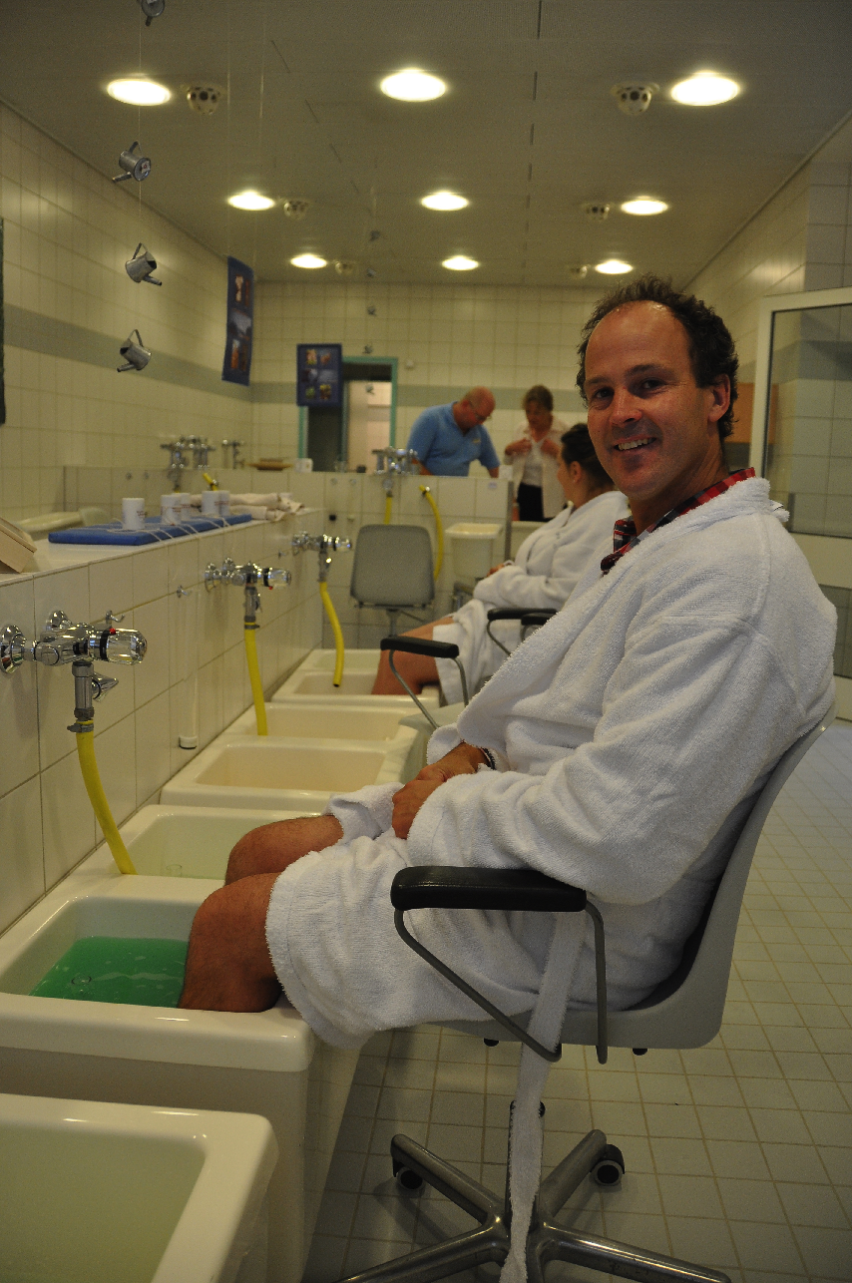
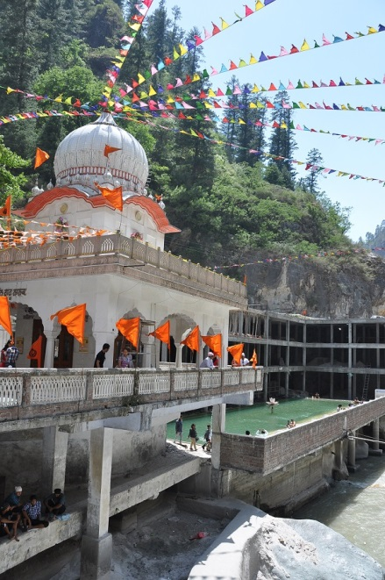
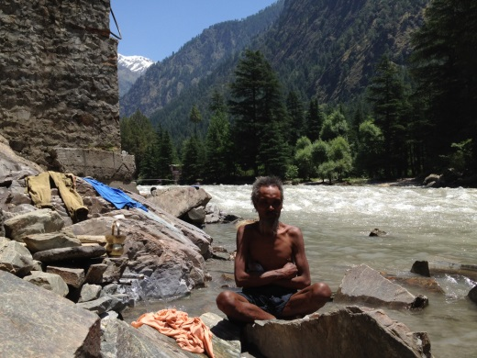
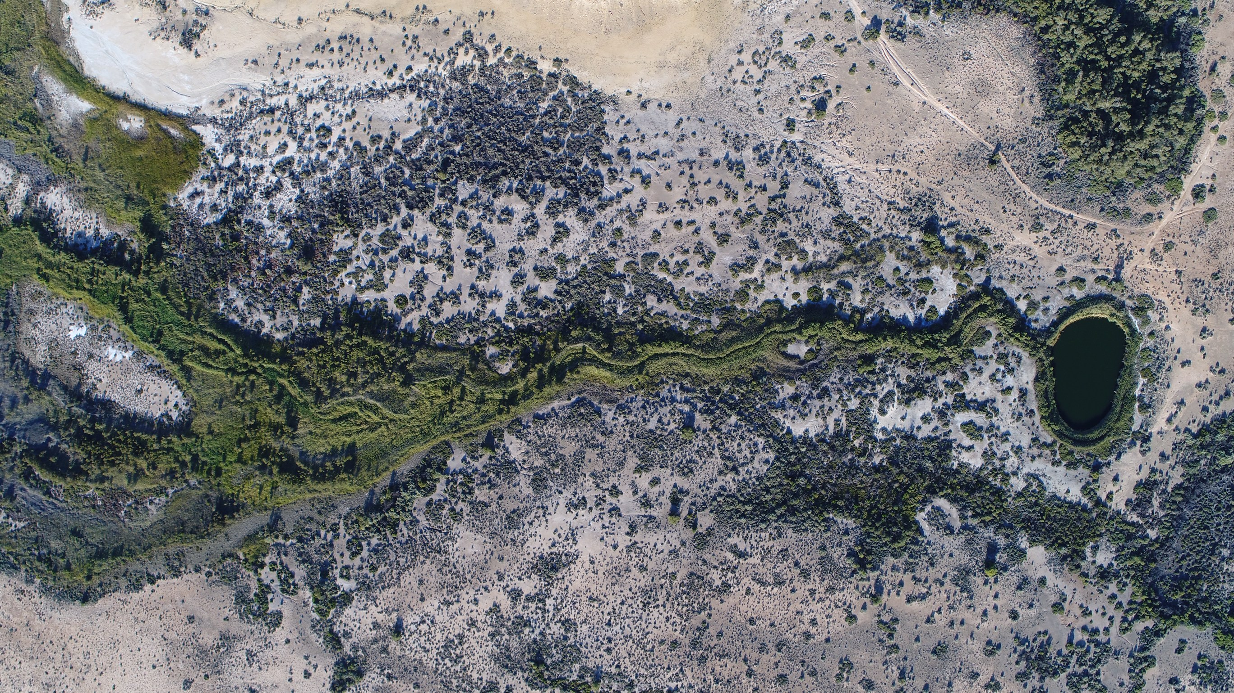
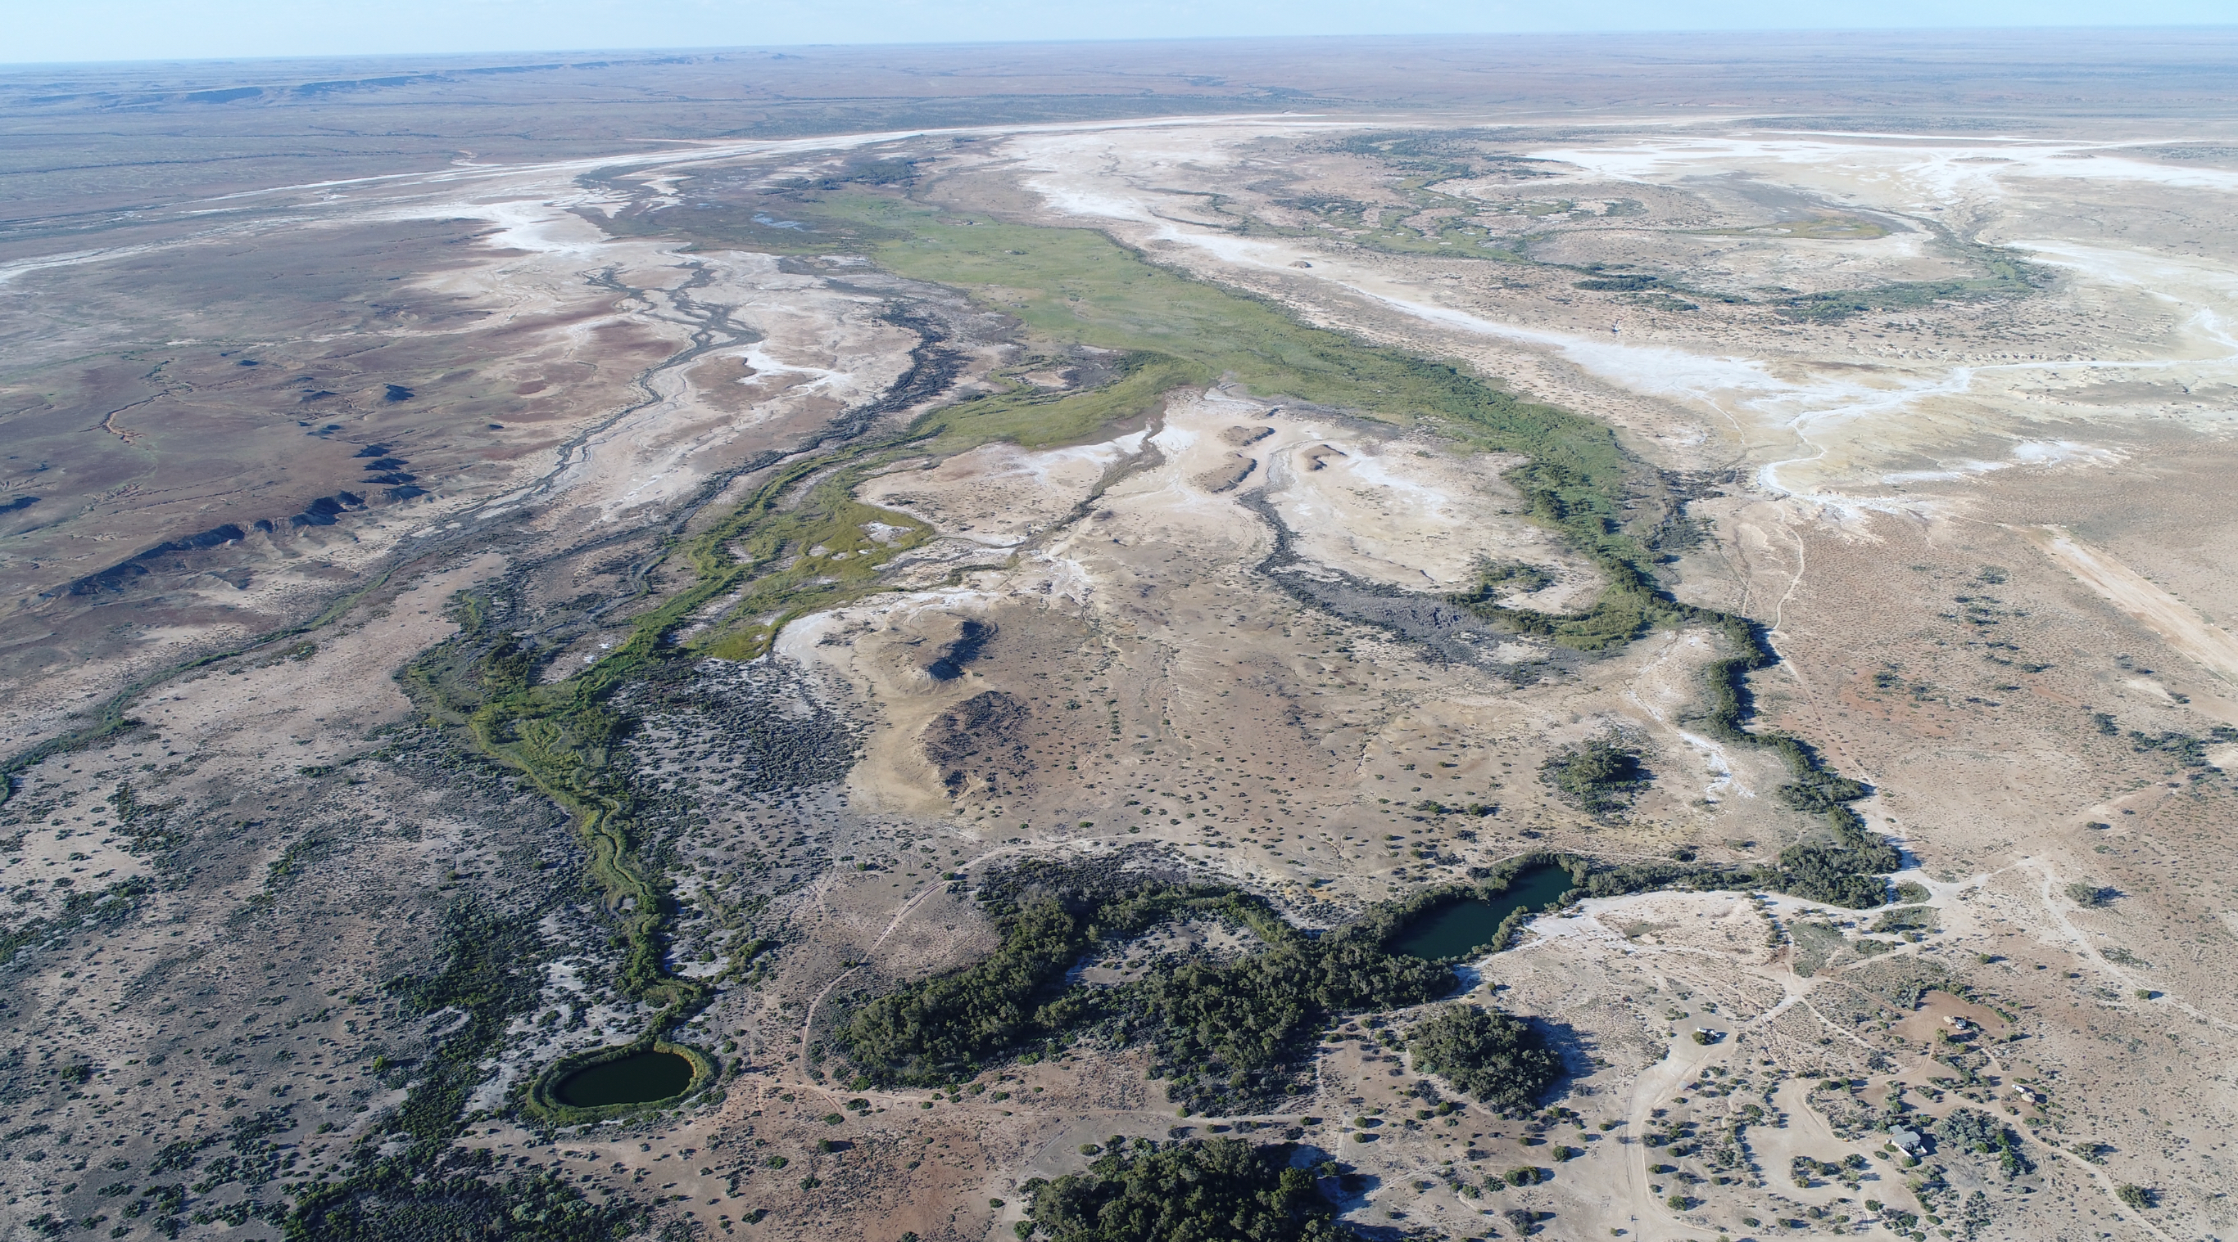
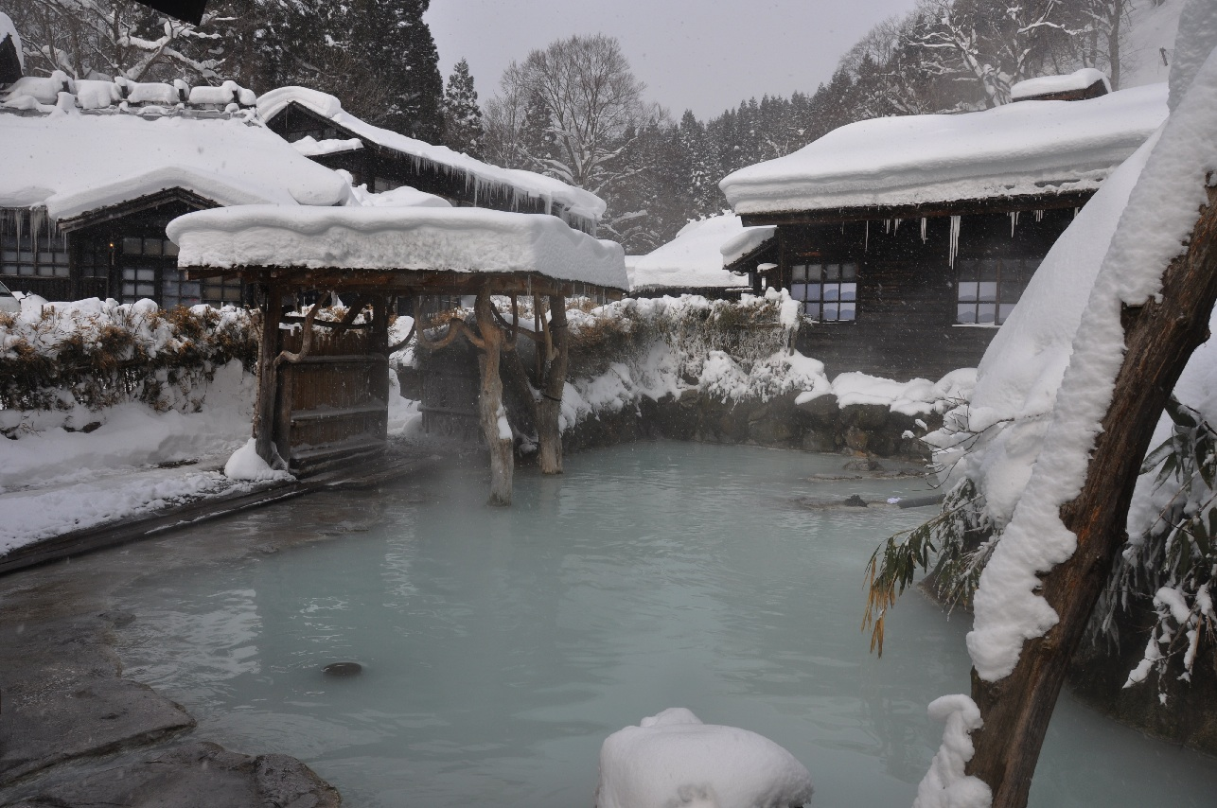
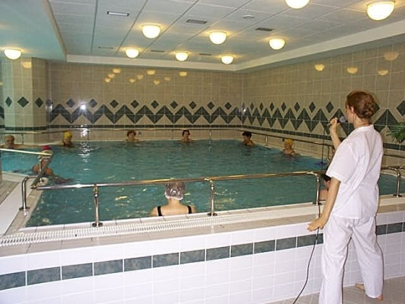
Japanese / Asian
Nature Springs
European
Health Springs
Indian / Indonesia / Australian
Spiritual Healing Springs
Notes:
Global practices vary from culture to culture. All lead to a greater sense of relaxation, wellbeing and connection. Connection to self, others and the environment.
Three broad categories of thermal mineral spring usage: Asia – nature and social connection ; Europe – medical/health usage for the purpose of ‘cure’ and social connection; Indigenous cultures – spiritual respect and cleansing and social connection.

Slide 5
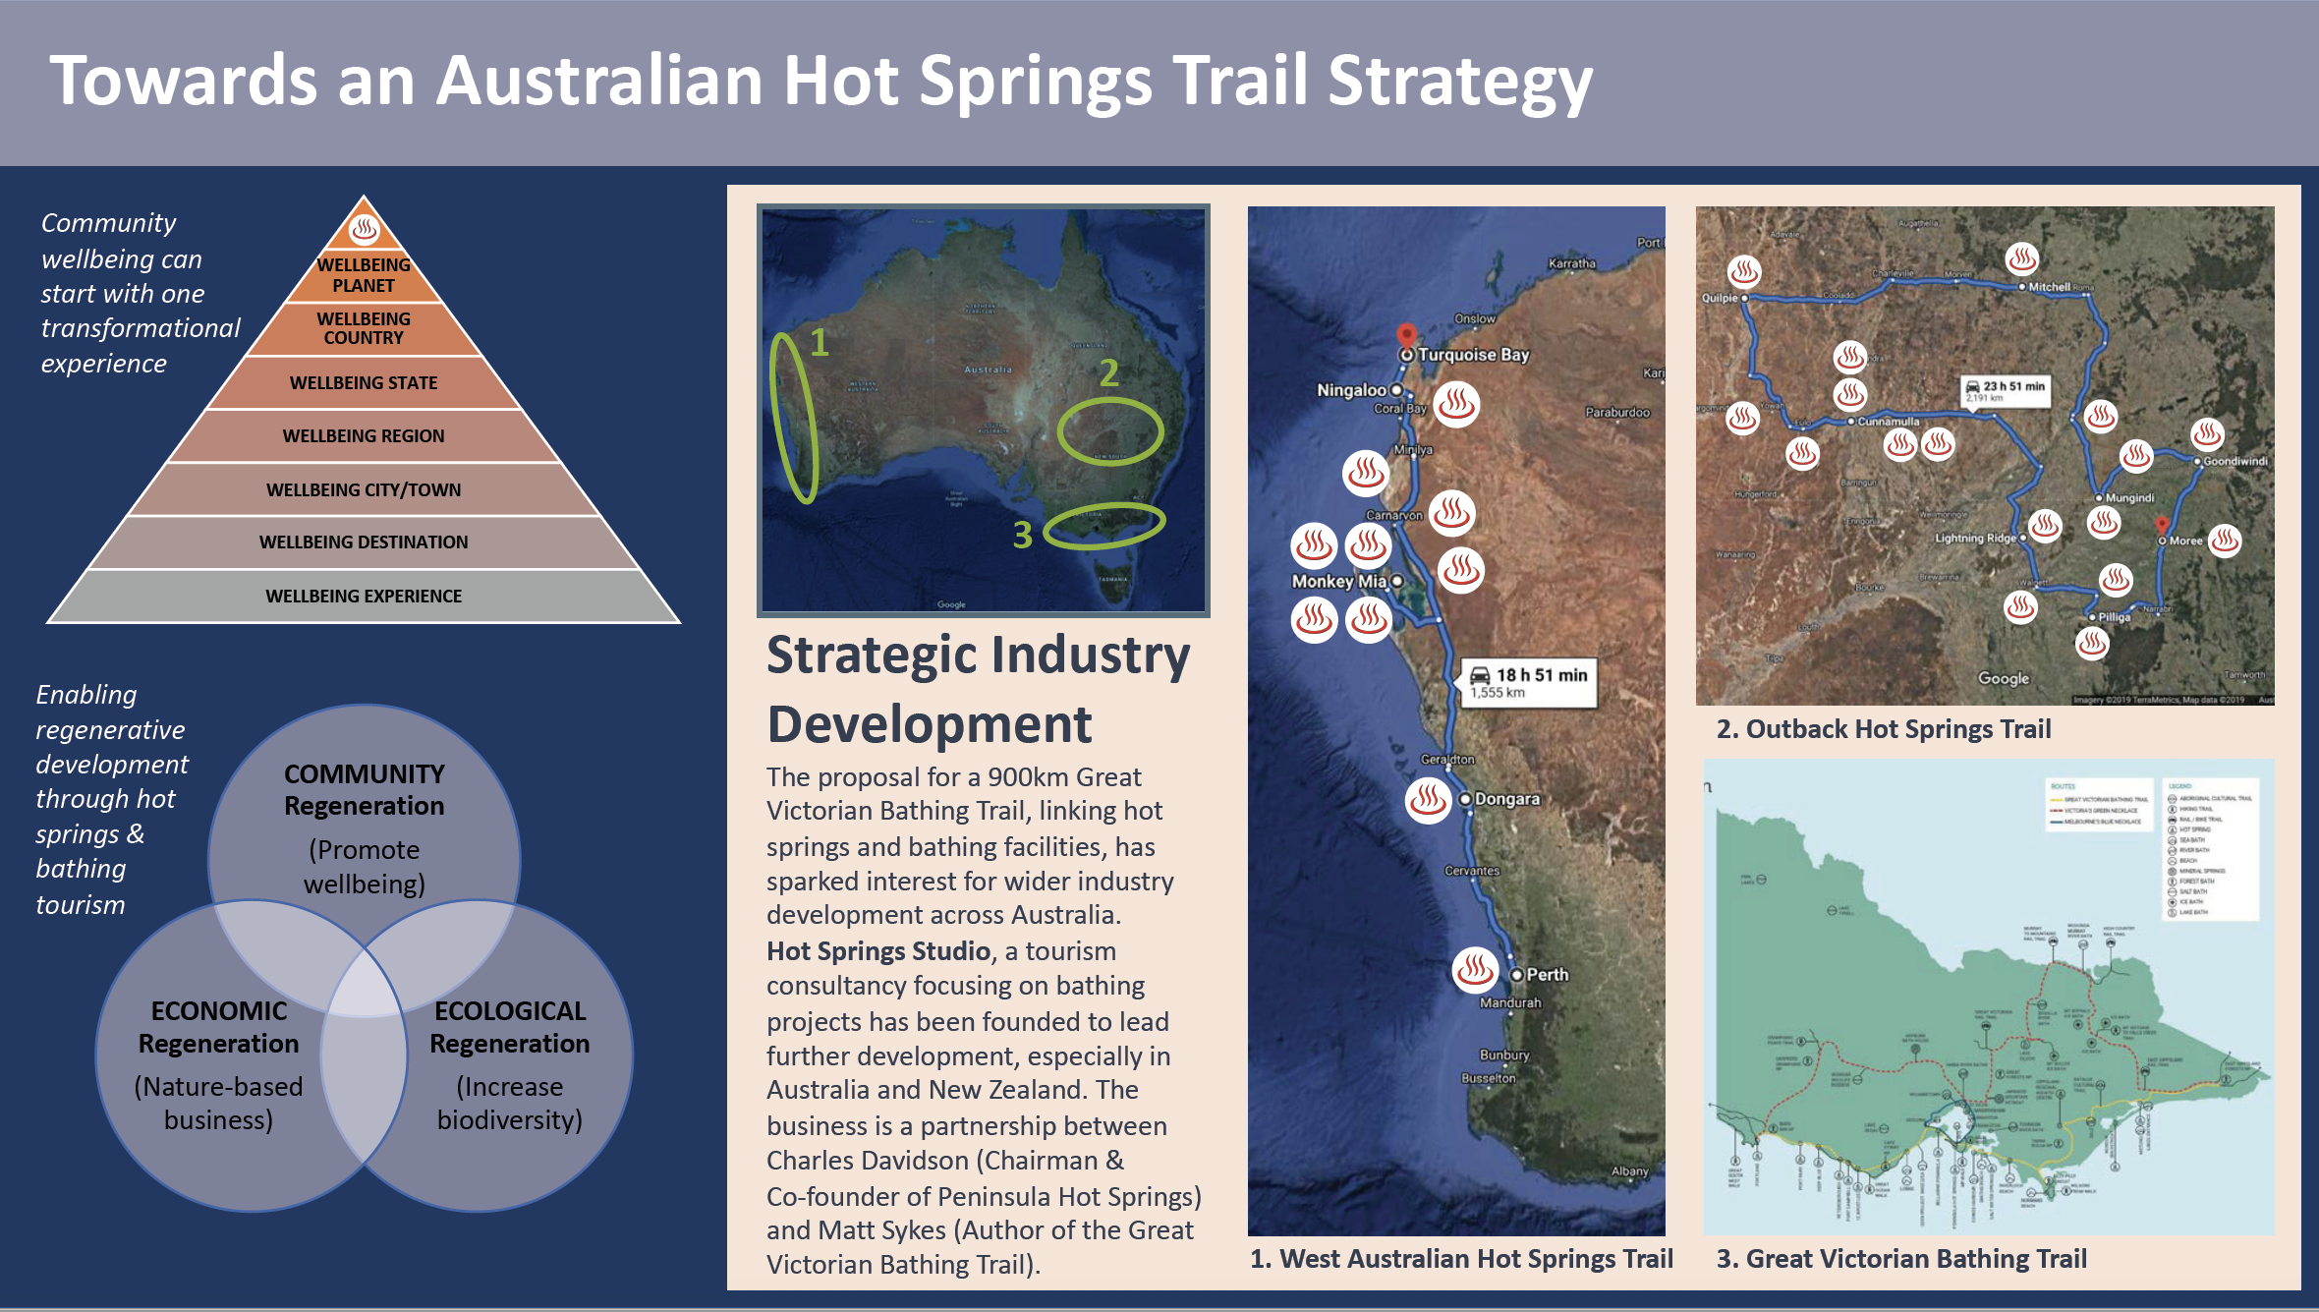
Notes:
Hot Springs Bathing Trail – a means of connecting hot springs to their local community and to each other. The whole is greater than the sum of the parts.
There are many other trails around the globe in Colorado, Canada, New Zealand, Japan and China to mention a few. Largely these are about connecting people to experiences and doing it in a way that is collaborative to raise awareness through the collective.

Slide 6
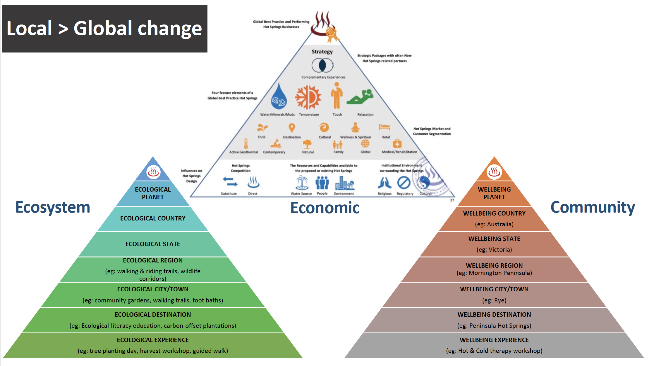
Notes:
Triple bottom line all start with the experiences we offer that should consider the consequences of their being from a social, environmental and economic perspective.
A hot & mineral spring spa lead initiative to help with the COVID-19 recovery
Charles Davidson
28 April, 2020
Triple-bottom-line resilience through collaboration
“A new balance can arise from this existential threat to humanity that sees the environment and community sit alongside the economy rather than being its servant.” Charles Davidson
Introduction
As the impact of COVID-19 is felt across the globe, national and international hot springs associations are coordinating meetings to proactively and collaboratively develop responses to survive, revive and then thrive as an industry sector. The questions that are being asked at these meetings are reflective of the deep problems the tourism and health sector is facing and also highlight the incredible opportunity this globally-connected sector holds.
Examples include:
April 22 2020: USA Hot Springs Business & Trade Association Briefing via Zoom, Discussions about new standards and protocols for re-opening
Hot Spring Industry Office of the Chongqing Municipal Commission of Culture & Tourism Development in China – Partnerships to enhance the development of an international Hot Springs Wellness Park in Chongquing, China
April 28 2020: World Federation of Hydrotherapy and Climatotherapy (FEMTEC), Discussions on the perception of Health SPAs / thermal centers as healthcare facilities.
April 30 2020: Global Wellness Institute Hot Springs Initiative – Strategic discussions on global collaborative efforts to emerge from the crisis, initially domestic and gradually international.
Preventative health solutions to an age-old challenge
As we find ourselves in the middle of the pandemic, we look for solutions to bring us back to what we love; our families, our communities, our countries and our world. We know this problem will very likely happen again, so we need to learn from this and build as much resilience and strength as possible. Without the immediate protection of vaccines, and acknowledging the virus’ capacity to mutate, we are told by medical experts that having a healthy immune system is our best personal defense. Dr Richard Carmona,17th Surgeon General of the United States, reminds us, “Your body’s first line of defense against any infectious disease is your immune system; maintaining and enhancing your immune system begins with actions you take to optimize your nutrition, exercise, sleep, social connections and mental health.” Similarly, Australian Aboriginal Elder Anne Warren, from the mountainous Ya-idt’midtung Country in South East Australia, encourages the practice of ‘conscious wellness’ based on the physical, emotional, mental, social and spiritual self.
In an article published in the Straits Times in Singapore on 21 March, 2020 the writer quoted the World Health Organisation’s advice on how to boost your health to fight Covid-19. The WHO recommended:
First, eat a healthy and nutritious diet, which helps your immune system to function properly.
Second, limit your alcohol consumption, and avoid sugary drinks.
Third, do not smoke
Fourth, exercise.
Fifth deal with stress, confusion and fear by talking to friends and family and by being compassionate, listening to music, reading or by playing games.
Furthermore, in a World Health Organisation publication from the Regional Office for Europe in (‎1999), titled ‘Healthy living: what is a healthy lifestyle?’ they state: ‘Health is not only just about avoiding disease. It is also about physical, mental and social wellbeing. When a healthy lifestyle is adopted, a more positive role model is provided to other people in the family, particularly children.’
Reconnection and a shift beyond business as usual
The primary tourism problem that we are seeking to solve is enabling travelers to re-connect to each other and the world around them with a sense of safety, harmony, health and wellbeing. We would also like to see the framework upon which business decision-making is undertaken to evolve to truly take into account the triple bottom line; to understand that we are custodians and not owners; and that we are all share the one world and can leave it in a better place if we make a conscious effort to do so.
Through our global collaborative engagement, hot springs tourism leaders see our unique capability to facilitate this reconnection and paradigm shift. We are aiming to give hot springs visitors of all nationalities and all ages the reason to travel together or alone for heath, wellbeing and recreation. We will encourage them to visit on a repeated basis, to stay longer and to spend more across the regions in which they travel. We also want them to be doing it with care and consciousness about the communities and environments in which they travel.
Hot springs are both unique and abundant, being found in nearly every country on earth. They are attractive to people of all cultures, all ages and all socio economic backgrounds.They are in demand in all seasons and in all weather conditions. They provide health and wellbeing for hundreds millions of people and provide significant permanent and part time employment. Our project provides a framework for the tourism industry to facilitate the building of hot springs bathing trails that enable and encourage investment, co-opetition (cooperative competitive evolution), and the dispersal of visitors to and around regions.
From pioneering destination operators to global hot springs trail designers
My business, Peninsula Hot Springs, located 1.5 hour’s drive south of Melbourne in Australia, has been trying over the past 15 years to blend hot springs bathing learnings from global cultures into experiences that help visitors ‘relax in nature and connect with the deep wellness of their being’. This is our written purpose as a company. We also believe in ‘Corporate Responsibility to Society’ and creating ‘International Understanding through Hot Springs’. Until the COVID-19 outbreak we were receiving 550,000 annual visitors and were set to grow to 750,000 in the coming 2-3 years as accommodation, the Food Bowl, Relaxation Sleeping Lounges and other elements of the masterplan come together. We have also been working with our colleague at Hot Springs Studio, Matt Sykes, on a special project called ‘Hot Springs Bathing Trails’ which aspires towards a global constellation of wellbeing tourism trails. This builds upon existing bathing trails in Colorado, Canada and New Zealand which provide a social, environmental and economic framework for the identification of trails and appropriate destination development locations. The trails not only provide a visual link (literally dots on the map) for visitors to follow, but also identify the investment opportunities along the trails that can help the whole be greater than the sum of the parts. We move from growth by competition to growth by conscious co-opetition where we give the triple-bottom-line a corridor along which it can emerge.
Hot springs trails as accelerators for the broader tourism industry
There are a lot of things we can be doing to be the change we want to see in the world. The main one is shifting our collective consciousness to one in which we share the world and we respect, embrace and learn to love the differences we all bring. The hot springs world is one in which we can bring those cultural differences wonderfully together in transformational experiences. Our proposal for a global network of hot springs trails, will not only have benefits to this sector but also incredible flow-on benefits to the broader tourism industry and community. We believe that a global industry with a shared purpose and a clear roadmap on how to achieve it can help us unite and be the change we want to see in the world.

Slide 7
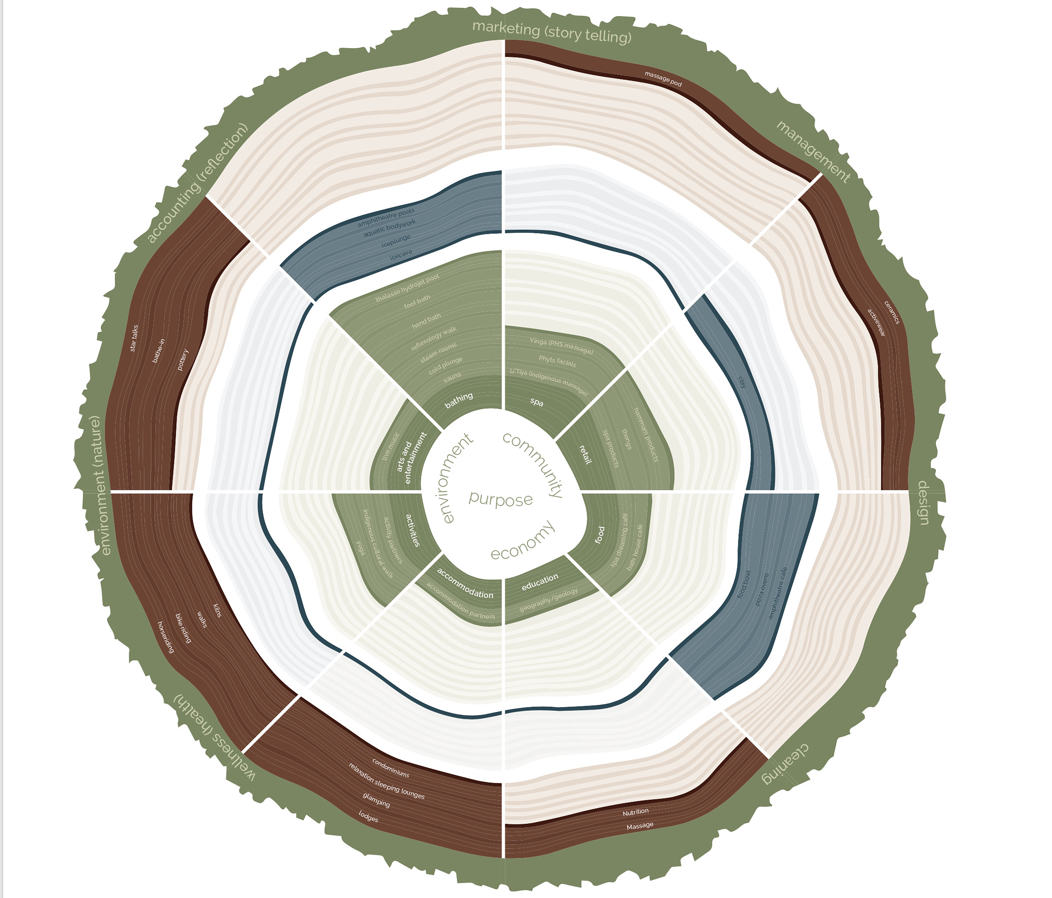
Notes:
The creative innovation tree. A model experience development decision making based on a purpose lead triple bottom line accountability.

Slide 8
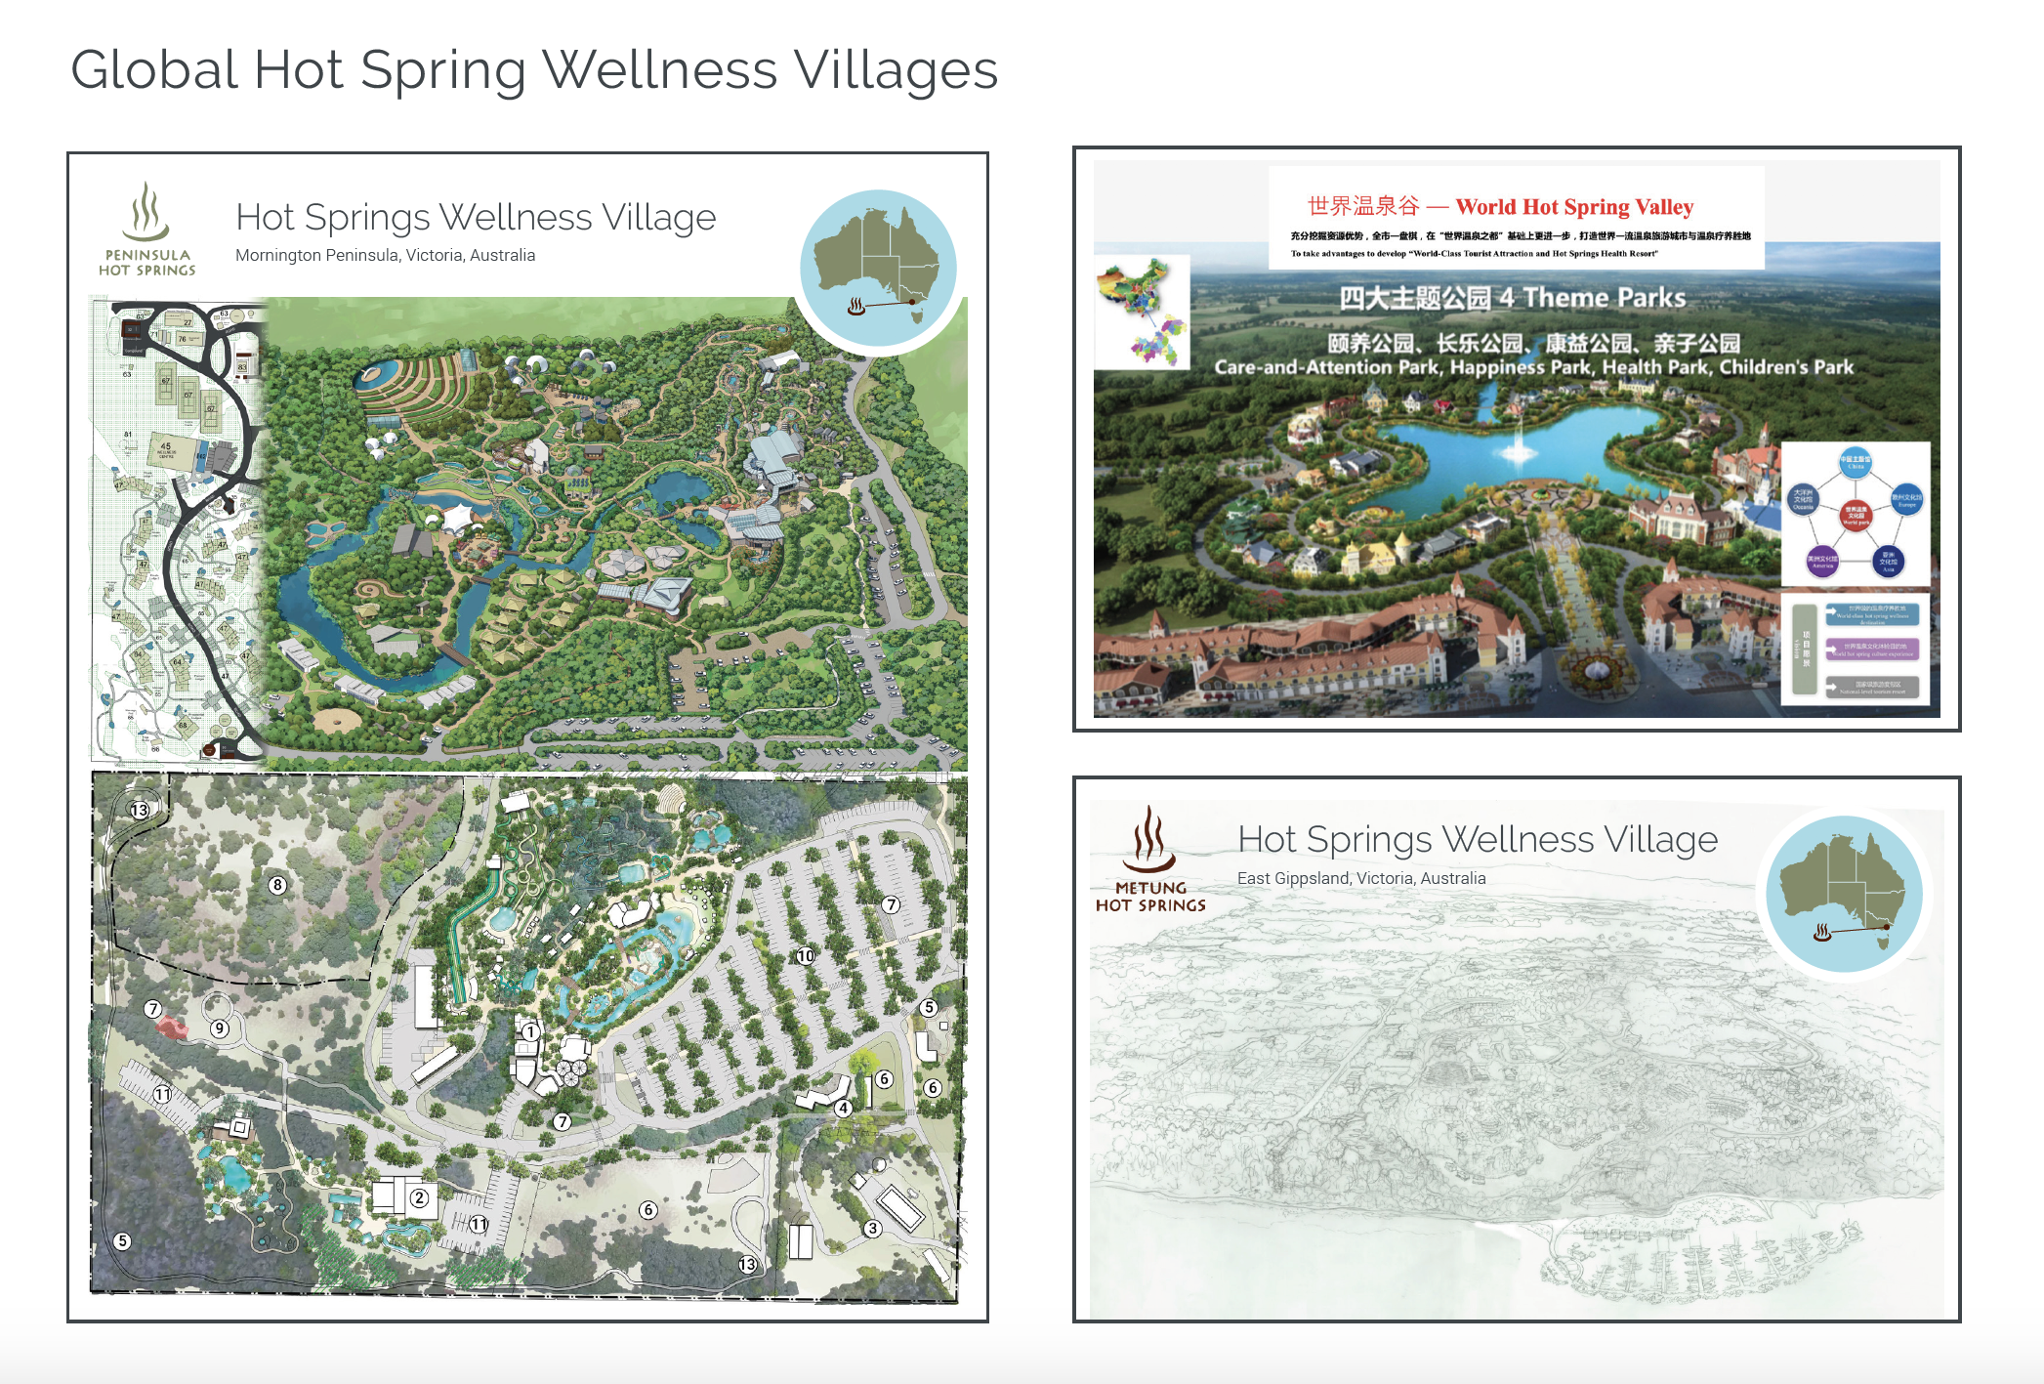
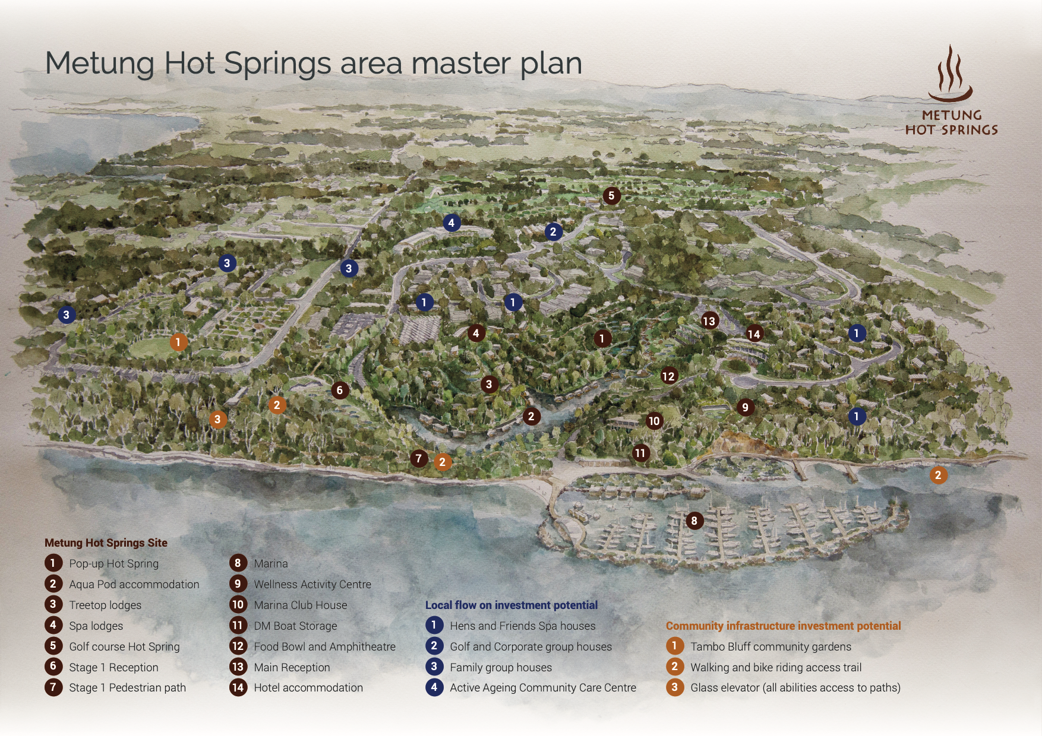
Notes:
Global examples of Hot Springs Villages designed with a focus on all of life and building globally connected communities.
Peninsula Hot Springs – Australia
Chongquing Hot Springs Wellness Park – China
Metung Hot Springs – Australia

Slide 9

Victoria University and the Australian Hot Springs Industry PhD Scholarship Study into the Social, Environmental and
Economic Impact of Hot Springs
An international collaborative research opportunity
International Collaboration
International Collaboration
Charles Davidson
Chairman Peninsula Hot Springs
Chairman Global Wellness Institute Hot Springs Initiative
Notes:
Project Description – The Australian hot springs and spa industry and its role in regional development
Hot Springs and spas are a central component of the growing ‘wellness’ industry and one of the fastest growing seterrctors within the visitor economy. The Global Wellness Institute (2018) estimates that the wellness tourism industry generates US$4.2 trillion for the world economy, with the hot springs and spa economy generating $175 billion as an industry sub-sector. In many parts of the world, hot springs have a long history embedded within national cultural practices. In Australia, however, hot springs and spa experiences are in the early stages of development although there are several well-known and highly successful hot springs and spa centers in operation. In Victoria, these include hot springs that stretch across Victoria’s coastline from Metung, Seacombe West, Phillip Island, the Mornington Peninsula, the Twelve Apostles on Great Ocean Road and Warrnambool.
Industry analyses demonstrate that hot springs and spa facilities have generated considerable direct and indirect economic benefits to local economies. In some instances, the hot springs have been the catalyst for significant regional growth providing a central attraction to support a much larger visitor economy. However, while there is an emerging body of research relating to the hot springs and spa industry, existing research is primarily focused on the economic benefits from visitation as well as the health benefits of bathing and alternative therapies. Investigating the alignment of the industry with regional development goals will address a gap in the current academic literature and inform industry policy in relation to regional development strategies. The research is also timely given that the industry is forecast to grow substantially over the next ten years with proposed new developments across Victoria and in other states.
This research proposes to investigate the wider social, cultural and environmental impacts of the industry and the extent to which the growth aligns with regional development goals of building stronger, resilient communities and sustainable employment. The broad aim will be to examine the how hot springs and spa centers have or have not contributed to enhanced community wellbeing and quality of life by the stimulation of local economies, improved local livelihoods, enhanced cultural diversity, environmental enhancement and improved services.
Project objectives will include to:
Trace the development of the hot springs and spa industry in Australia;
Identify measures of regional well-being relevant to the existence and operations of hot springs and wellness facilities such as those relating to employment, income, environment, health and services;
Applying these measures, identify the contribution of hot springs and spa developments to the wellbeing of local and regional communities;
Explore the relationship between hot springs and spas to community wellbeing;
Identify opportunities for future development to enhance regional development objectives.
The research will be facilitated by the project sponsors, the Australian Geothermal Association and include case studies of hot springs and spa resorts across Australia in:
Western Australia: Tawarri Hot Springs
Northern Territory: Katherine Hot Springs
Queensland: Cunnamulla Hot Springs and Talaroo Hot Springs
NSW: Moree Artesian Spa
South Australia: Dalhousie Springs
Victoria: Peninsula Hot Springs, Deep Blue Hotel and Hot Spring; Phillip Island Hot Springs & Metung Hot Springs.
Tasmania: Hastings Cave and Thermal Springs
The research will be supervised by Dr Joanne Pyke and Professor Terry De Lacy within ISILC and under the umbrella of the School for the Visitor Economy.
Monitor, G. W. E. (2018). "The Global Wellness Tourism Economy, 2015 - 2017, October 2018, https://globalwellnessinstitute.org/wp-content/uploads/2019/04/Global-Wellness-Economy-Monitor2018_v8FINAL_ExecutiveSummary_web.pdf."

